Slide 1
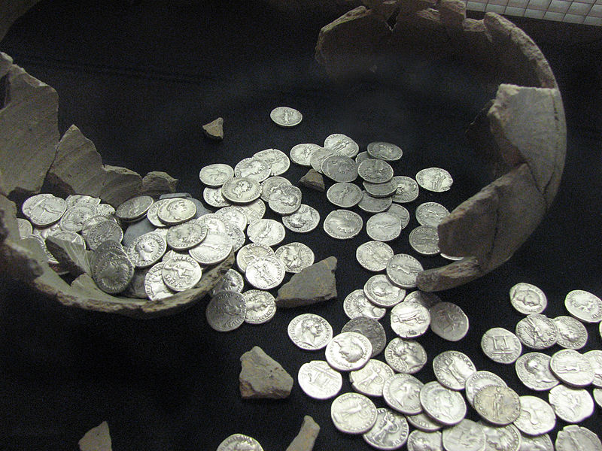
1 Timothy 6.6-12
[pew Bible p.1340]
commons.wikimedia.org

Slide 2
1 Timothy 6.6-12 NET: Now godliness combined with contentment brings great profit. For we have brought nothing into this world and so we cannot take a single thing out either. But if we have food and shelter, we will be satisfied with that. Those who long to be rich, however, stumble into temptation and a trap and many senseless and harmful desires that plunge people into ruin and destruction. For the love of money is the root of all evils. Some people in reaching for it have strayed from the faith and stabbed themselves with many pains. But you, as a person dedicated to God, keep away from all that. Instead pursue righteousness, godliness, faithfulness, love, endurance, and gentleness. Compete well for the faith and lay hold of that eternal life you were called for and made your good confession for in the presence of many witnesses.

Slide 3
1 Timothy 6.6-8: Now godliness combined with contentment brings great profit. For we have brought nothing into this world and so we cannot take a single thing out either. But if we have food and shelter, we will be satisfied with that.
God
Spiritual Blessings
Deliverance
Trust and Obey Revelation
Deliverance
God’s Physical Blessings
You
Rely on Human Methods
Your Physical Blessings

Slide 4
1 Timothy 6.6-8: Now godliness combined with contentment brings great profit. For we have brought nothing into this world and so we cannot take a single thing out either. But if we have food and shelter, we will be satisfied with that.

Slide 5
Philippians 4.11-13 NET: I am not saying this because I am in need, for I have learned to be content in any circumstance. I have experienced times of need and times of abundance. In any and every circumstance I have learned the secret of contentment, whether I go satisfied or hungry, have plenty or nothing. I am able to do all things through the one who strengthens me.

Slide 6
In any and every circumstance I have learned the secret of contentment, whether I go satisfied or hungry, have plenty or nothing. I am able to do all things through the one who strengthens me.
God
Spiritual Blessings
Deliverance
Trust and Obey Revelation
Deliverance
God’s Physical Blessings
You
Rely on Human Methods
Your Physical Blessings

Slide 7
1 Timothy 6.9-10: Those who long to be rich, however, stumble into temptation and a trap and many senseless and harmful desires that plunge people into ruin and destruction. For the love of money is the root of all evils. Some people in reaching for it have strayed from the faith and stabbed themselves with many pains.

Slide 8
Those who long to be rich, however, stumble into temptation and a trap and many senseless and harmful desires that plunge people into ruin and destruction.
God
Spiritual Blessings
Deliverance
Trust and Obey Revelation
Deliverance
God’s Physical Blessings
You
Rely on Human Methods
Your Physical Blessings

Slide 9
For the love of money is the root of all evils. Some people in reaching for it have strayed from the faith and stabbed themselves with many pains.
God
Spiritual Blessings
Deliverance
Trust and Obey Revelation
Deliverance
God’s Physical Blessings
You
Rely on Human Methods
Your Physical Blessings

Slide 10
Proverbs 30.8b-9 NIV: …give me neither poverty nor riches, but give me only my daily bread. Otherwise, I may have too much and disown you and say, ‘Who is the LORD?’ Or I may become poor and steal, and so dishonor the name of my God.

Slide 11
1 Timothy 6.11-12: But you, as a person dedicated to God, keep away from all that. Instead pursue righteousness, godliness, faithfulness, love, endurance, and gentleness. Compete well for the faith and lay hold of that eternal life you were called for and made your good confession for in the presence of many witnesses.

Slide 12
Hebrews 13.5 NET: Your conduct must be free from the love of money and you must be content with what you have, for he has said, “I will never leave you and I will never abandon you.”

